Slide 1
Ralph Ellison
Invisible Man

Slide 2

Ralph Ellison
Invisible Man

Slide 3
6 Elements of the Narrative
Character
Plot
Setting
Theme
Conflict
Point of View

Slide 4
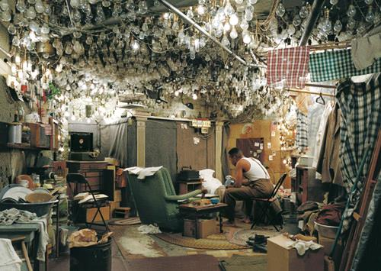
Ralph Ellison
Invisible Man

Slide 5
Characters
Invisible Man
Sleepwalker
Louis Armstrong
Preacher
Woman & her Sons
Ras the Destroyer

Slide 6
Plot
Violent street encounter
Invisible Man hibernating down in his hole
Rent-free in a Whites only bldg.
Stealing Power
Dream descent into Jazz music

Slide 7
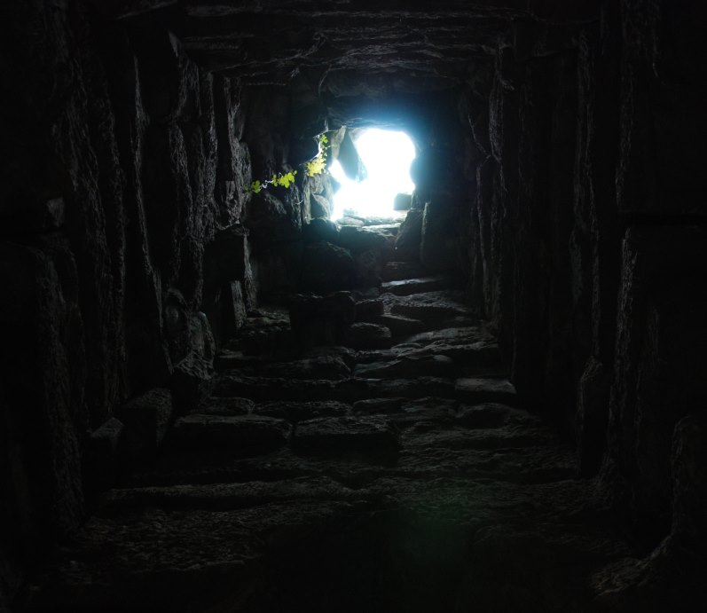
Bouquet
By Langston Hughes
Gather quickly
Out of darkness
All the songs you know
And throw them at the sun
Before they melt
Like snow

Slide 9

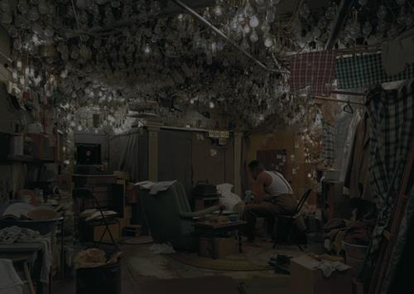
In and around Harlem, New York
1952
Basement cave – 1,369 light bulbs
Mind-altered
Dreamscape

