Slide 1

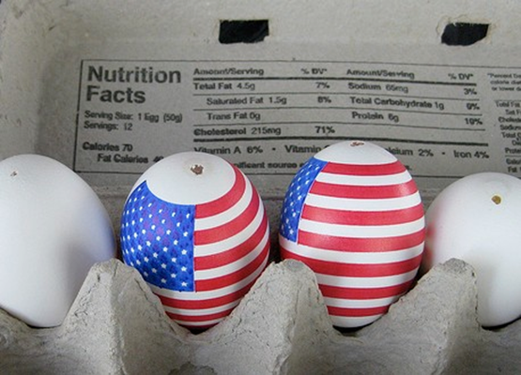

Slide 3
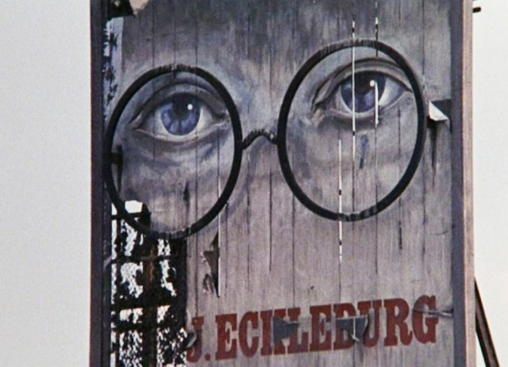
Published: 1925
Setting: Long Island and New York City - Summer 1922

Slide 4
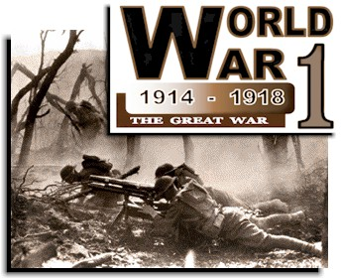

Slide 5

Post WWI
Economy prospered as America aimed
to forget the troubles of war
While most lived below the poverty level, the standard of living sharply increased for many

Slide 6
Post WWI
Americans abandoned small towns
in exchange for urban living
The Great Migration –
“The Southern Diaspora”

Slide 7
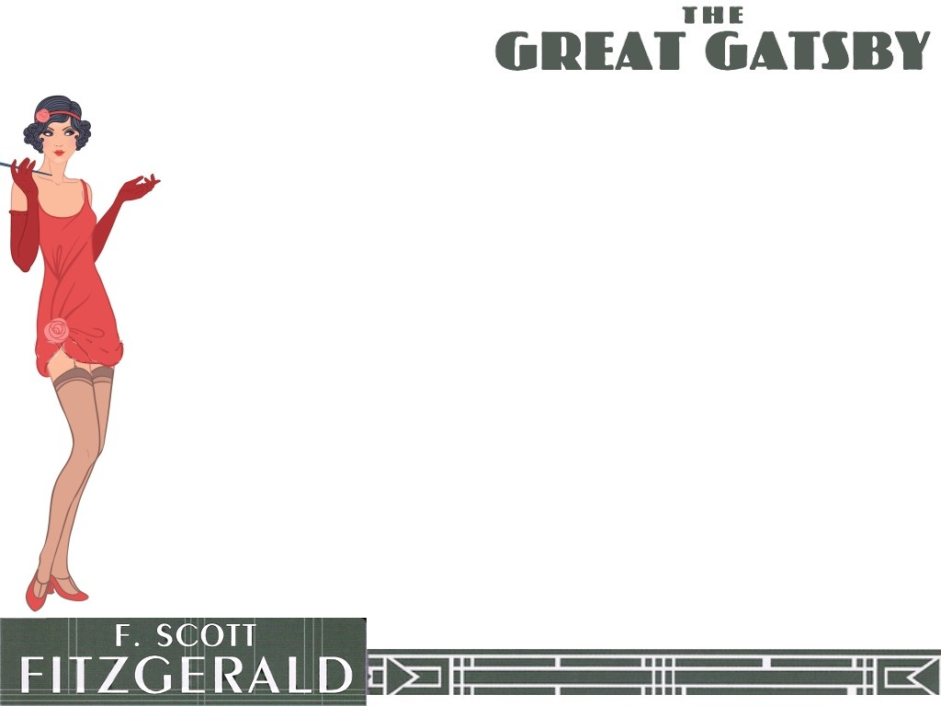
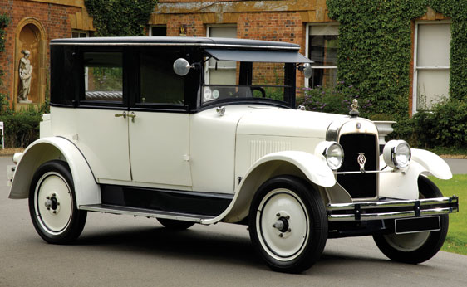
The 1920s
Roaring ‘20s
Flapper Era
The Aspirin Age
Age of Wonderful
Nonsense
The Jazz Age

Slide 8

The Jazz Age
Years 1918-1929: after the end of WWI, continuing through the 1920s until the start of the Great Depression
Takes its name from the African American based jazz music which became popular across many segments of society
Period of pleasure seeking
and reckless jubilance

Slide 9
The Jazz Age
Prohibition
18th Amendment to Constitution prohibited manufacture and sale of alcoholic beverages
Bootlegging and “mob” activity increased

Slide 10

The Jazz Age
WWI made Americans question traditional values and ideals
Literature and art denied foundations of the past
The philosophy of the Jazz Age was called "modernism"

Slide 11
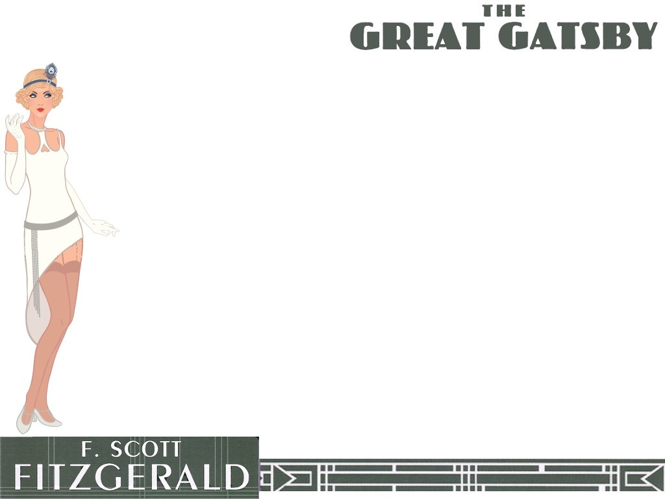
The Jazz Age - Modernism
Writers stripped away descriptions of characters and setting and avoided direct statements of themes and resolutions
This fragmented style of writing enabled each reader to find his/her own meaning

Slide 12
The Lost Generation
Hemingway, in his novel The Sun Also Rises depicts a group of expatriate Americans, wandering aimlessly through Europe, sensing that they are powerless and that life is pointless in the aftermath of the “Great War”

Slide 13
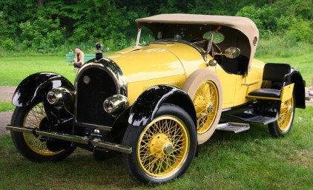
The Lost Generation
Hemingway credits the phrase to Gertrude Stein - she credits the garage owner who serviced her car

Slide 14
The Lost Generation
Fitzgerald’s novel can be seen to encapsulate this perception of
life without purpose
restlessness
a mindless quest for pleasure
dissatisfaction and drifting
loss of direction in life

Slide 15
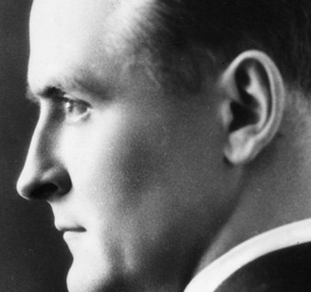
The Lost Generation
Fitzgerald, like narrator
Nick Carraway in his novel, idolized the riches and glamor of the age, but was uncomfortable with the unrestrained materialism and the lack of morality
that went with it

Slide 16

Themes
Jazz Age - Roaring Twenties
Decline of the American Dream
Social Class Differences
Social Position of Women
The Automobile
Prohibition - Organized Crime

Slide 17
Themes
Success and Failure
Wealth - Old vs. New
Hope and ‘sense of purpose’
Illusion vs. Reality
Honesty vs. Lies
Time: role the past plays in dreams,
goals and achievements of the future

Slide 18
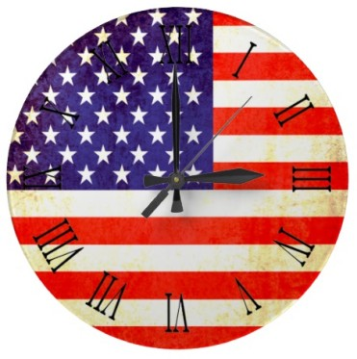
Motifs
Connection between Events and Weather
Connection between Geographical Location and Social Values
Images of Time
Extravagant Parties
The Quest for Wealth

Slide 19
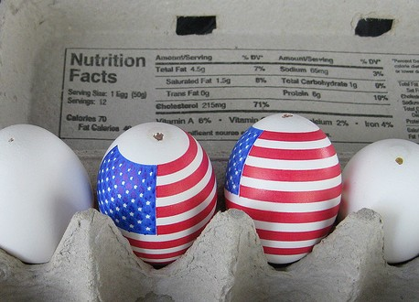
Symbols
The eyes of
Doctor T. J. Eckleburg
East Egg, West Egg
Money and wealth symbols (cufflinks, shirts)
Dust and ash – “the valley of ashes”
(Eliot, The Wasteland, 1922)

Slide 20
Symbols
Green light on
Daisy’s dock
Gatsby’s parties
Significance of various colors
The role of symbols themselves in the human conception of meaning

Slide 21
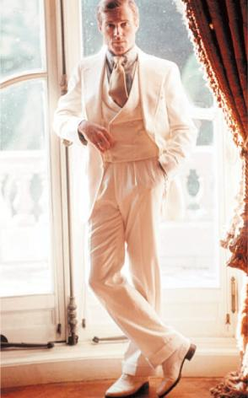
Central Characters
Nick Carraway
Daisy Buchanan
Tom Buchanan
Jordan Baker
Myrtle Wilson
George Wilson
Meyer Wolfshiem
James Gatz – Jay Gatsby

Slide 22
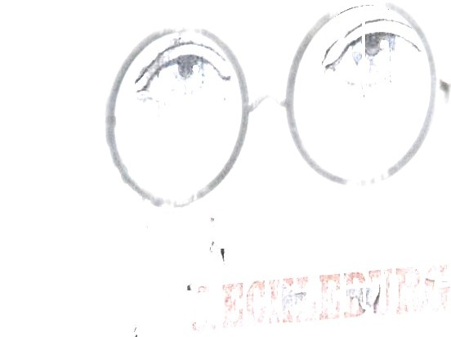
The mystery of Jay Gatsby becomes the central question of the novel and seems to shape the structure and tonal quality of the narrative

